Slide 1

Recommendation for MLB Expansion City
Data-Driven Analysis and Prediction
Ebenezer Olubayode

Slide 2

Problem
Goal: Identifying most profitable and stable intercontinental city for a new MLB franchise via data-driven insights
Success Metrics Could Include:
Population size and growth potential
Economic Factors e.g. Median Household Income
Sports Market Saturation (Other Pro League)
Existing Baseball Ecosystem (Minor League Teams)

Slide 3

DATA COLLECTION & SOURCES
Data was collected for both cities with existing 30 MLB teams and 385 cities with and without MLB teams to identify patterns and evaluate potential markets for expansion, covering metrics such as:
Population size (city and metro).
Median household income.
Total revenue of MLB teams.
Minor league and other sports teams (NFL, NBA, NHL, MLS)
Presence of minor league teams (AAA, AA, A).
Sources; Forbes, US Census Data and others

Slide 4
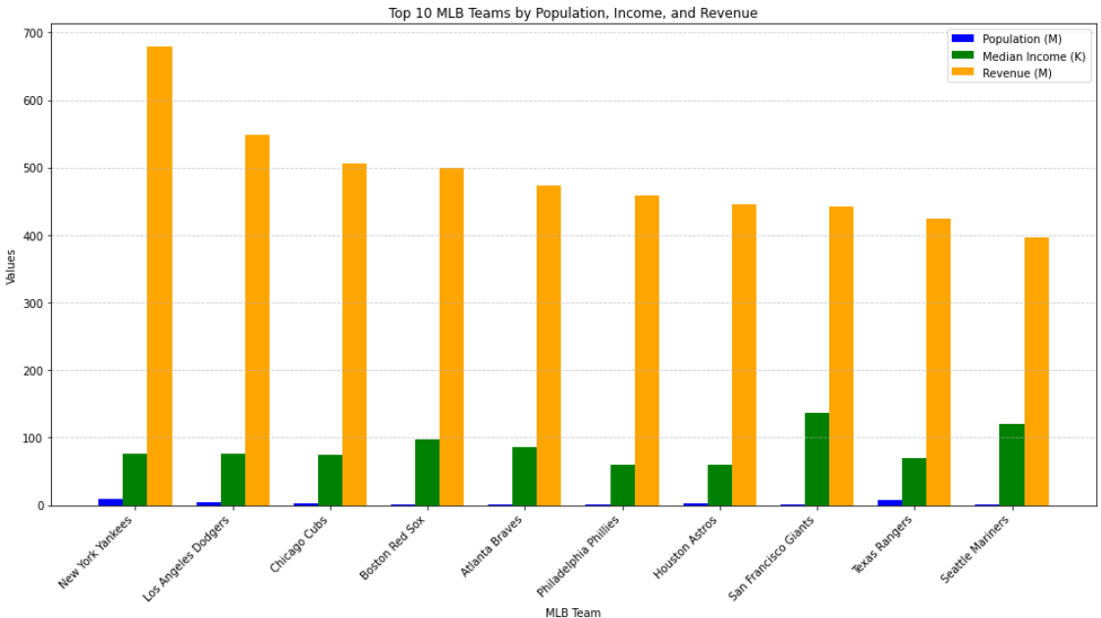
Current Market Size of MLB Teams
Teams like New York Yankees and Los Angeles Dodgers generate significantly higher revenues, indicating dominant markets.
Lower revenue team may struggle in smaller or less lucrative markets.
Revenue is likely influenced by median Income and fan engagement and other economic factors

Slide 5
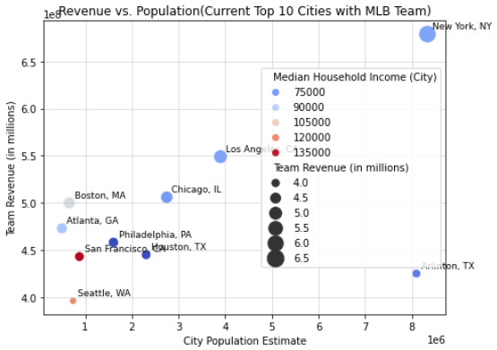
Current Market Size of MLB Teams
A positive correlation between population and revenue is evident (e.g., New York and Los Angeles lead both population and revenue).
Some smaller cities like San Francisco achieve high revenues despite lower populations, likely due to high median incomes or strong brand value compared to Houston and Arlington with larger Population.
Income levels play a role, as higher-income cities (e.g., San Francisco, Boston) tend to generate higher revenues even with moderate populations.

Slide 6
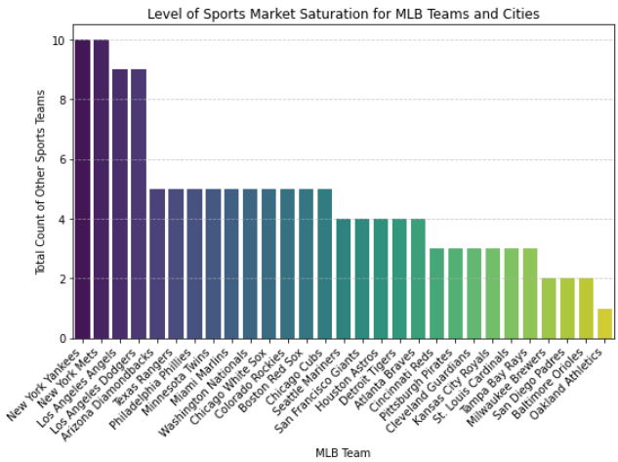
Current Market Size of MLB Teams
Sports Market Saturation
Cities like New York and Los Angeles are heavily saturated with other professional teams.
This saturation may create competition for fan engagement but also indicates strong sports markets.
Cities with fewer competing teams (e.g., Seattle or Oakland) may rely more heavily on MLB for sports entertainment.

Slide 7
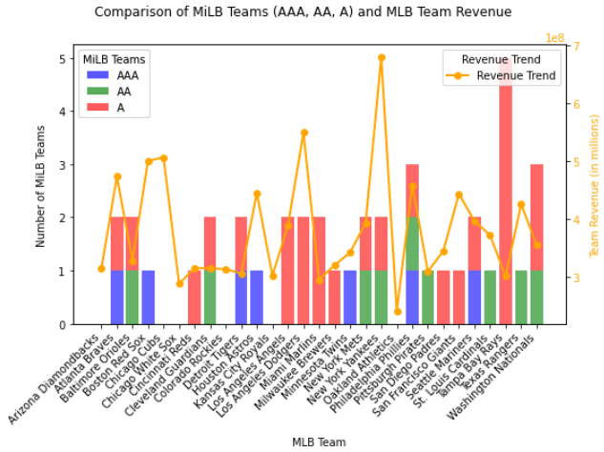
Current Market Size of MLB Teams
Relationship Between MiLB Teams and Revenue:
Teams with a balanced presence across AAA, AA, and A levels in their Cities tend to show stronger ecosystems, which might correlate with consistent revenue (e.g., Yankees, Giants).
High revenue teams don’t always rely on a strong MiLB presence (e.g., Dodgers), suggesting market size and branding could be factors.
Outliers:
Washington Nationals: High AAA team presence but moderate revenue, highlighting a potential gap in leveraging minor league ecosystem presence in the city.
Tampa Bay Rays: Low MiLB presence in the city and low revenue,

Slide 8

FINDINGS
Revenue Drivers:
Population and income are factors but are not absolute determinants.
MiLB Presence Supports Revenue, But It's Not a primary driver:
Market Saturation:
Saturated cities like New York and Los Angeles can still thrive due to their large populations and economic power.
Markets with fewer competing teams may offer opportunities for deeper fan engagement.
Expansion Opportunities:
New MLB markets should prioritize cities with a balance of population, income, and minimal competition from other sports like NFL, MLS, NHL, NBA and also Cities with MiLB (esp. AAA)

Slide 9
METHOD/APPROACH
A regression model was used to determine the relationship between various factors (population, income, sports saturation and total Pro League) and MLB team revenue.
The model was trained using both standardized and unstandardized features to calculate coefficients and identify the importance of each predictor."
Features included:
Populations (city population and metropolitan population) and income metrics.
Counts of other professional sports teams (A new feature, total_Pro_league, counts of all professional sports teams in a city)
Minor league baseball presence (AAA, AA, A).

Slide 10
Features Importance and Impacts on MLB Revenue
Standardized Coefficient: compare the relative importance of features
Larger absolute values indicate stronger effects on revenue.
Unstandardized Coefficient: the actual impact of each feature on revenue
P-Value:
Indicates the statistical significance of the feature:
p < 0.05: Statistically significant.
p ≥ 0.05: Not statistically significant.
Significance:
Clearly labels each feature as ‘Significant’ or ‘Not Significant’ based on the p-value.
Features | Standardized Coefficient | Unstandardized Coefficient | P-Value | Significance
City Population Estimate | 25840500 | 1.086862e+01 | 0.367946 | NO
Median Household Income (City) | 10282910 | 4.634968e+02 | 0.537526 | NO
Metropolitan Population Estimate | 17653830 | 3.816077e+00 | 0.689971 | NO
NFL Count | 923996.4 | -7.229860e+06 | 0.410123 | NO
NBA Count | 14038120 | 1.270969e+07 | 0.581616 | NO
NHL Count | -25795520 | -4.048852e+07 | 0.030477 | YES
MLS Count | 33184880 | 4.566937e+07 | 0.780204 | NO
AAA | 30937830 | 7.229821e+07 | 0.056851 | NO
AA | 17571270 | 3.798088e+07 | 0.329891 | NO
A | 8691899 | 8.346709e+06 | 0.609195 | NO
Total_Pro_league | 3789407 | 1.066068e+07 | 0.004223 | YES

Slide 11
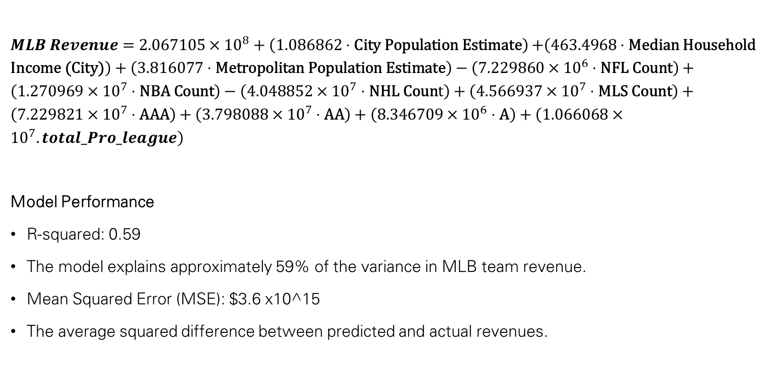
Regression Model Equation/Perfromance
$MLB Revenue=2.067105×{10}^{8}+\left(1.086862⋅\text{City} \text{Population} \text{Estimate}\right)$ $+\left(463.4968⋅\text{Median} \text{Household} \text{Income}\text{ (}\text{City}\text{)}\right)+\left(3.816077⋅\text{Metropolitan} \text{Population} \text{Estimate}\right)−\left(7.229860×{10}^{6}⋅\text{NFL} \text{Count}\right)+\left(1.270969×{10}^{7}⋅\text{NBA} \text{Count}\right)−\left(4.048852×{10}^{7}⋅\text{NHL} \text{Coun}\text{t}\right)+\left(4.566937×{10}^{7}⋅\text{MLS} \text{Count}\right)+\left(7.229821×{10}^{7}⋅\text{AAA}\right)+\left(3.798088×{10}^{7}⋅\text{AA}\right)+\left(8.346709×{10}^{6}⋅\text{A}\right)+\left(1.066068×{10}^{7}.total_Pro_league\right)$
Model Performance
R-squared: 0.59
The model explains approximately 59% of the variance in MLB team revenue.
Mean Squared Error (MSE): $3.6 x10^15
The average squared difference between predicted and actual revenues.

Slide 12
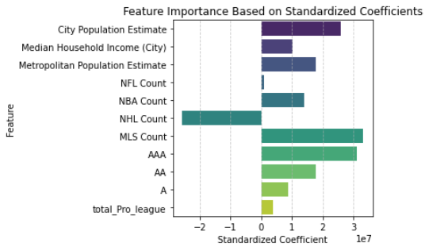
Interpretations
Population as a Revenue Driver:
City Population Estimate has the strongest positive influence on MLB revenue, underscoring the importance of targeting larger markets for MLB expansion or team success.
Economic Factors :
While Median Household Income (City) shows a positive impact, it is not statistically significant, indicating that revenue depends more on population size than local income levels.
Professional Sports Competition (Market Saturation):
NHL Count negatively impacts revenue the most among competing leagues ($-40.49M per additional team), highlighting the challenges MLB faces in hockey-dominated markets.
Conversely, MLS Count shows a positive (though not statistically significant) correlation, suggesting soccer may complement rather than compete with MLB in some cities.

Slide 13
Interpretations
Total Professional Teams as a Cultural Indicator:
Cities with a higher total_Pro_league (count of NFL, NBA, NHL, MLS, and MLB teams) demonstrate a positive revenue impact ($10.66M per additional team), indicating that a vibrant sports culture benefits MLB.
Minor League Baseball (MiLB) Presence:
AAA Teams provide the strongest minor league contribution to revenue ($72.30M per team), emphasizing the importance of top-tier minor league systems in developing fan engagement and talent pipeline.
Insights
Expansion into larger markets with established sports cultures and a strong minor league presence (especially AAA) is likely to maximize revenue potential.
Cities with fewer NHL teams may offer less competition for MLB fan engagement and higher revenue opportunities.

Slide 14
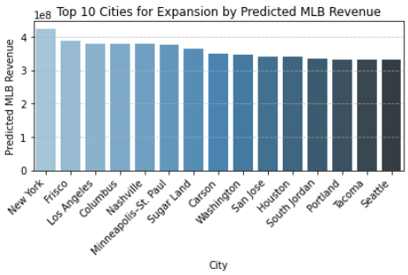
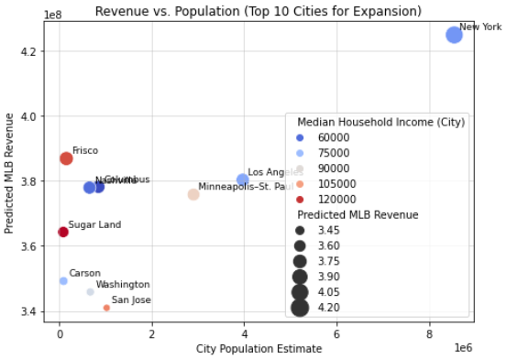
TOP 10 Cities
Among the 385 cities selected :
New York, Frisco, and Los Angeles dominate due to their combination of market size and/or economic strength.
Cities like Carson, Washington, and San Jose rank lower, reflecting their more saturated markets or limited population bases.
Smaller cities like Frisco and Sugar Land have lower populations but rank high in revenue due to higher median incomes.
Los Angeles, Minneapolis–St. Paul, and Nashville cluster near the top, balancing population and income.

Slide 15
TOP CITIES WITH POSSIBLE REVENUE
New York Leads by a Wide Margin:
Predicted MLB Revenue: $424.96M.
Population: 8.55M with moderate median income ($67K).
Despite already being a saturated market, New York’s size and economic activity still make it the top candidate.
Frisco as a High Revenue Candidate:
Predicted Revenue: $386.89M, ranking 2nd.
Despite its smaller population (154K), Frisco benefits from a high median household income ($116.88K), indicating significant spending power in the region.

Slide 16
TOP CITIES WITH POSSIBLE REVENUE
Los Angeles Stands Out:
With a large population (3.97M) and strong economic activity, Los Angeles ranks 3rd with $380.33M in predicted revenue.
However, this market may already be saturated with other professional sports teams.
Cities with Balanced Growth Potential:
Columbus ($378.18M), Nashville ($377.94M), and Minneapolis–St. Paul ($375.81M) rank 4th, 5th, and 6th, respectively, combining moderate population and income levels with potential for additional sports market penetration.
Smaller Markets with High Income:
Sugar Land ($364.28M): Although the population is small (88K), its high median income ($123.26K) elevates its potential revenue.

Slide 17
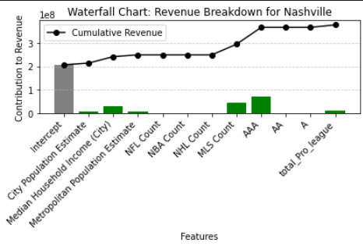
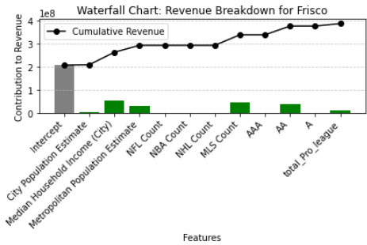
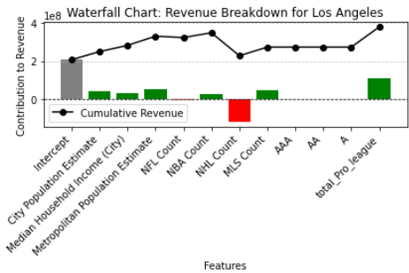
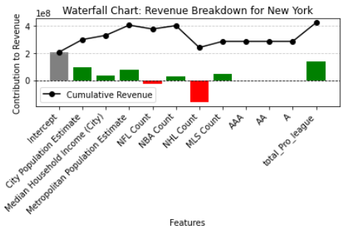
TOP CITIES AND CONTRIBUTOR FACTORS

Slide 18
Recommendations
Prioritize Large Cities with Untapped Potential
Nashville, Columbus, and Minneapolis–St. Paul provide strong growth opportunities with moderate population sizes and spending power.
These cities also face less saturation compared to New York and Los Angeles.
Consider High-Income, Smaller Markets
Cities like Frisco and Sugar Land highlight the potential of affluent but smaller markets. Their high spending power compensates for their lower population bases.
Account for Market Saturation:
While cities like New York and Los Angeles generate high predicted revenues, their existing sports saturation may limit opportunities for additional MLB teams.

Slide 19
ADDITIONAL METRICS
These metrics would also be helpful for further analysis
Fan Engagement Metrics
Sponsorship and Partnership Deals

Slide 20
REFERENCES
https://www.forbes.com/lists/mlb-valuations/
https://www.census.gov/
https://infogalactic.com/info/U.S._cities_with_teams_from_four_major_league_sports

